Slide 1
Section F
DNA structure and replication
Guodong Yang
Biochemistry and Molecular Biology, College of Life Sciences
gdyang@sdau.edu.cn
13854808762

Slide 2
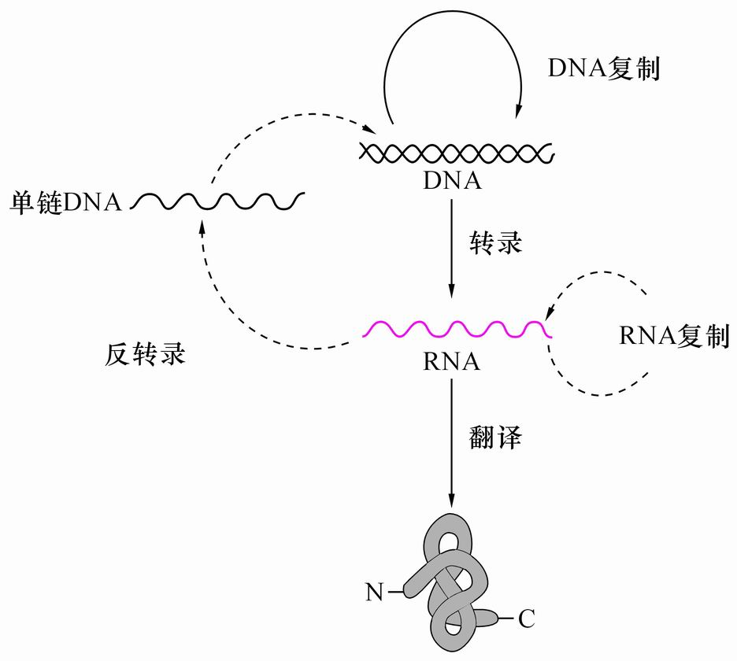
Genetic Central Dogma
中心法则

Slide 3
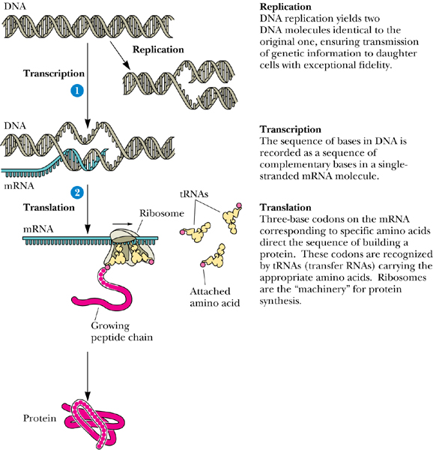

Slide 4
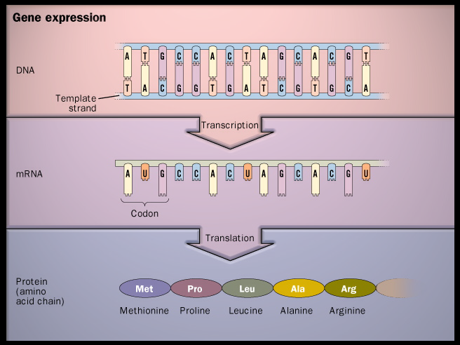

Slide 5
Section F DNA structure and replication
F1 DNA (RNA) structure
F2 Chromosomes
F3 DNA replication in bacteria
F4 DNA replication in eukaryote

Slide 6
Section F1 and G1
DNA (RNA) structure

Slide 7
1. The nucleic acids, deoxyribonucleic acid (DNA) and ribonucleic acid (RNA), are polymers of nucleotide units.
1.1 DNA consists of four kinds of deoxyribonucleotide units linked together through covalent bonds
1.1.1 Each nucleotide unit is made of a nitrogenous base (the various part in the four different deoxyribonucleotides), a pentose sugar, and a phosphate group.

Slide 8
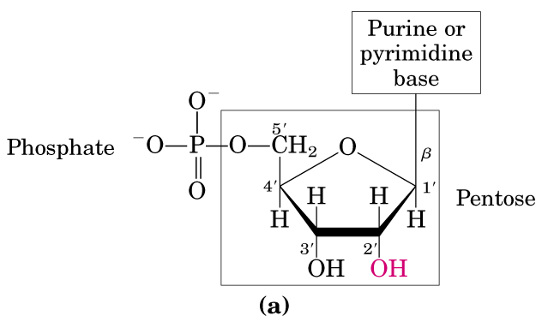
nucleoside
ribonucleotide
nucleic acids

Slide 9
Deoxypentose
H
deoxyribonucleotide

Slide 10
1.1.2 The nitrogenous base can be adenine (A), guanine (G), cytosine (C), or thymine (T) (uracil (U) in RNA).
1.1.3 The nitrogenous bases are derivatives of two parent compounds, pyrimidine （嘧啶）and purine（嘌呤）.

Slide 11
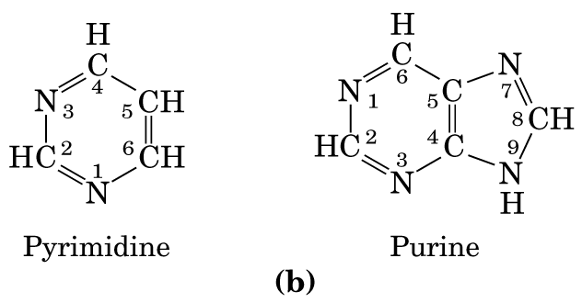
1.1.4 The carbon and nitrogen atoms in the purine and pyrimidine rings are numbered.

Slide 12
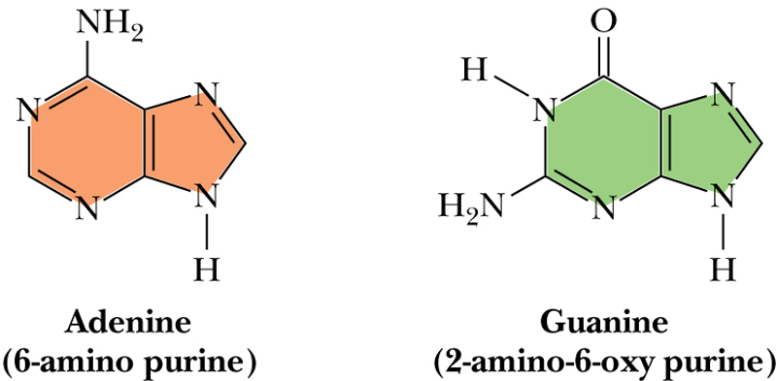
6
6
1
5
7
1
5
7
2
8
8
4
9
2
4
9
3
3

Slide 13
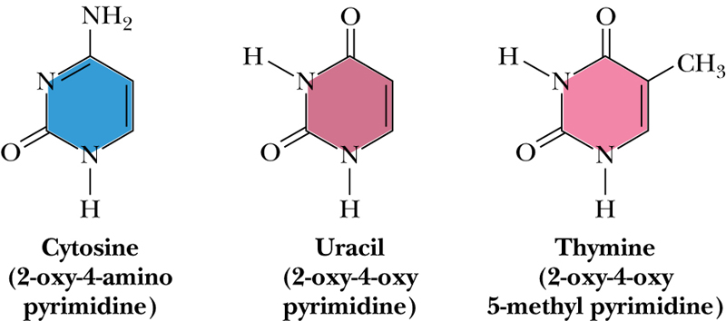
4
4
4
3
5
3
5
3
5
2
1
6
2
1
6
2
1
6
胞嘧啶
脲嘧啶
胸腺嘧啶

Slide 14
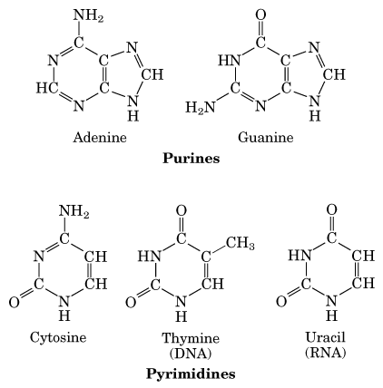

Slide 15
1.1.5 The pentose in a deoxyribonucleotide is a deoxyribose, which lacks an oxygen atom at the 2’-position that is present in ribose, the parent compound.
1.1.6 The deoxyribose is in its β-furanose form (a closed five-member ring).
1.1.7 Only D-deoxyribose is found in DNA.

Slide 16
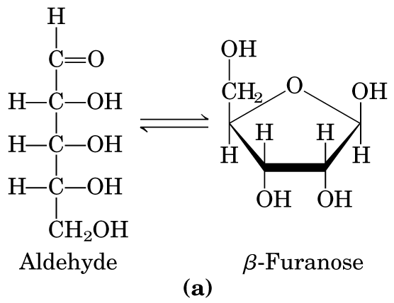
呋喃糖

Slide 17
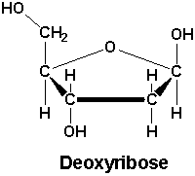
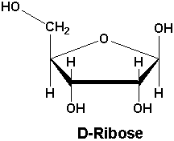
Deoxyribose and Ribose
D型
β型

Slide 18
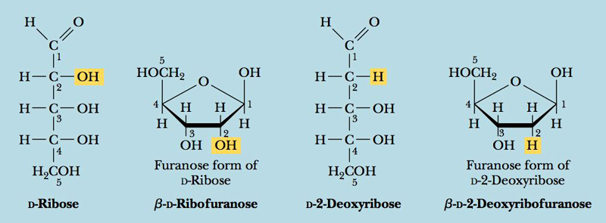
The atoms in the 5-carbon sugar are also numbered.
’
’
’
’
’
’
’
’
’
’
’
’
’
’
’
’
’
’
’
’

Slide 19
1.1.8 Each pyrimidine is covalently linked (through a N-glycosidic bond) to the 1’ carbon of the deoxyribose at N-1 of the pyrimidine, and each purine is covalently linked to the 1’ carbon of the deoxyribose at N-9 of the purine.

Slide 20
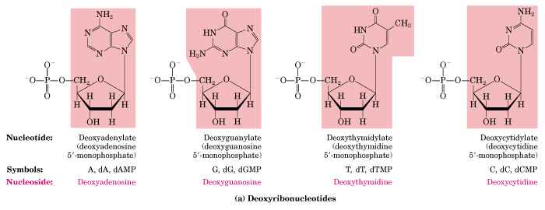
9
9
1
1
1’
1’
1’
1’
nucleoside（核苷）

Slide 21
1.1.9 The phosphate group is esterified to the -OH group on the 5’ carbon of the deoxyribose ring.
1.1.10 A nucleotide lacking the phosphate part is called a nucleoside（核苷）.
1.1.11 The four nucleoside units in DNA are called deoxyadenosine, deoxyguanosine, deoxythymidine, and deoxycytidine.
1.1.12 The nitrogenous base can be adenine (A), guanine (G), cytosine (C), or thymine (T) (uracil (U) in RNA).

Slide 22
1.1.13 The four nucleotide units in DNA are called deoxyadenosine 5’-monophosphate (dAMP, or deoxyadenylate), deoxyguanosine 5’-monophosphate (dGMP, or deoxyguanylate), deoxythymidine 5’-monophosphate (dTMP, or deoxythymidylate), and deoxycytidine 5’-monophosphate (dCMP, or deoxycytidylate).
1.1.14 In DNA the nucleotides are covalently joined together by 3’,5’-phosphodiester bonds to form a repetive sugar-phoshate chain which is the backbone to which the bases are attached.

Slide 23
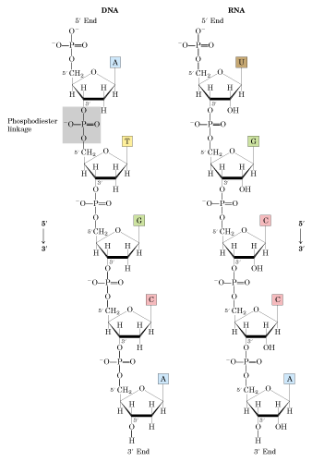
3’ hydroxyl group (3’-OH 基）
phosphodiester
5’phosphate group
5’
3’

Slide 24
1.2 RNA also consists of four different kinds of ribonucleotides.
1.2.1 Each ribonucleotide unit is also made of three parts: a nitrogenous base, a pentose, and a phosphate group.
1.2.2 The base part is adenine, guanine, cytosine or uracil.
1.2.3 Uracil exists only in RNA, and thymine only in DNA.

Slide 25
1.2.4 The pentose part is a ribose (without being deoxygenated at the 2’ position) in its β-furanose form (as deoxyribose in deoxyribonucleotides).
1.2.5 The bases and the phosphate group are covalently linked to the ribose ring in the same ways as in deoxyribonucleotides.
1.2.6 The four nucleoside units in RNA are called adenosine, guanosine, cytidine, and uridine (without deoxy- suffix); and the nucleotide units are AMP, GMP, CMP, and UMP.

Slide 31
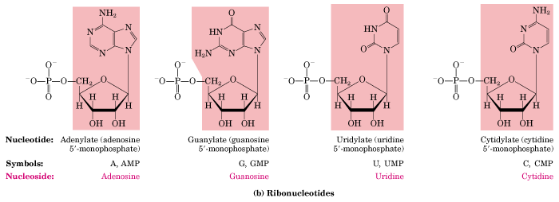

Slide 32
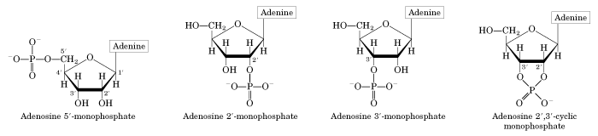

Slide 33
phosphodiester

Slide 34
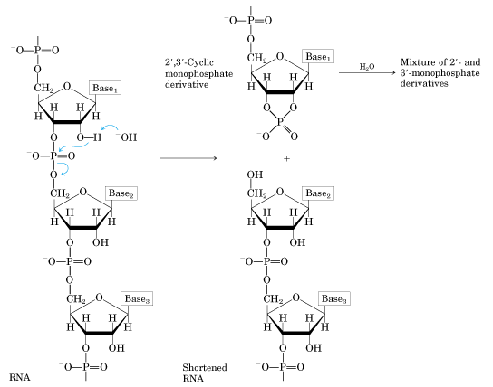

Slide 35
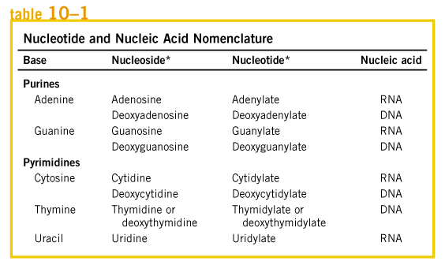

Slide 36
nucleic acids
deoxyribonucleic acid (DNA)
ribonucleic acid (RNA)
nucleotide , ribonucleotide, deoxyribonucleotide
nitrogenous base, ribose, phosphate
ribose: pentose sugar/ribose/deoxyribose; β-D-ribose; β-D-furanose, β-D-ribofuranose
β-D-2-deoxyribofuranose
nitrogenous base: adenine (A), guanine (G), cytosine (C), or thymine (T), uracil (U) .
pyrimidine, purine
N-glycosidic bond:
1’ carbon of the deoxyribose is covalently linked N-1 of the pyrimidine,
1’ carbon of the deoxyribose is covalently linked N-9 of the purine
Nucleoside:
deoxyadenosine, deoxyguanosine, deoxythymidine, and deoxycytidine
adenosine, guanosine, uridine, and cytidine
3’,5’-phosphodiester
Nucleotide:
deoxyadenylate deoxyguanylate deoxycytidylate deoxythymidylate
Adenylate guanylate cytidylate uridylate

Slide 37
1.3 DNA stores genetic information.
1.3.1 The amino acid sequence of every protein and the nucleotide sequence of every RNA molecule in a cell are all specified by the nucleotide sequence of that cell’s DNA molecule.

Slide 38
1.3.2 A segment of DNA that contains the information required for the synthesis of a functional protein or RNA is referred as a gene.
1.3.3 DNA is large biomacromolecule. In bacteria, all the genetic information is stored in a single DNA molecule; in a eukaryotic cell each chromosome contains one single DNA molecule.

Slide 39
1.4 RNA can be divided into several classes of different functions.
1.4.1 Ribosomal RNAs (rRNA) are structural components of ribosomes (the protein synthesis machine in cells).
1.4.2 Messenger RNA (mRNA) are copies of DNA (synthesized by DNA transcription), that carry the information of one or a few genes to the ribosomes, where the corresponding protein(s) is(are) synthesized.

Slide 40
1.4.3 Transfer RNA (tRNA) are adapter molecules that faithfully translate the information in a mRNA molecule into the specific amino acid sequences in a polypeptide chain.
1.4.4 Some RNA molecules, named as Ribozymes, have catalytic activities functioning in the processing (cleavage) of precursor RNA molecules (Thomas Cech and Sidney Altman won the Nobel Prize in Chemistry in 1989 for discovering ribozymes).

Slide 41
1.5 Nucleotides have roles other than being monomeric units of nucleic acids.
1.5.1 Nucleoside triphosphates are used as source of chemical energy to drive a wide variety of biochemical reactions.
1.5.2 ATP is the “energy currency” in cells (UTP, GTP, and CTP are also used in specific reactions as energy sources)

Slide 42
1.5.3 Adenosine diphosphate (ADP) is part of many coenzymes, e.g., coenzyme A, nicotinamide adenine dinucleotide (NAD⁺), flavin adenine dinucleotide (FAD).

Slide 43
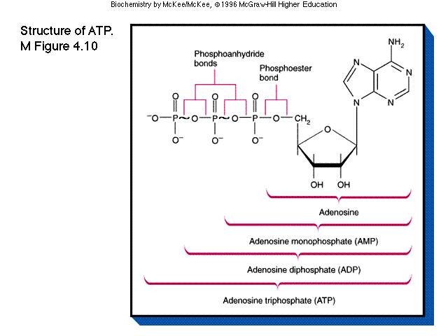

Slide 44
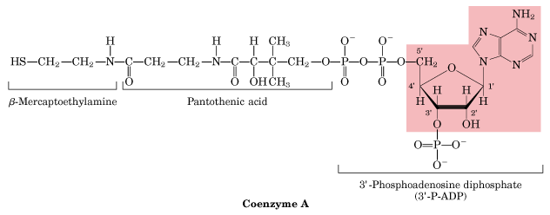
泛酸

Slide 45
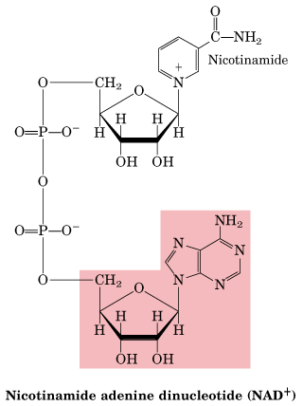

Slide 46
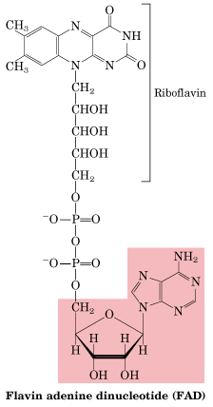

Slide 47
1.5.4 Adenosine 3’,5’-cyclic monophosphate (cAMP), guanosine 3’,5’-cyclic monophosphate (cGMP) function as secondary messengers in cell signal transductions.

Slide 48
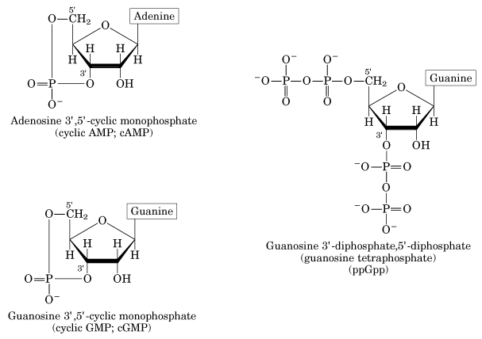

Slide 49
2. Phosphodiester bonds link successive nucleotides in nucleic acids (in both DNA and RNA)
2.1 The 3’-hydroxyl group of one nucleotide is joined to the 5’-phosphate group of the next nucleotide by a phosphodiester bridge.
2.1.1 The covalent backbones of nucleic acids consist of alternating phosphate and pentose (β-D-deoxyribose in DNA, β-D-ribose in RNA) residues.

Slide 50
phosphodiester

Slide 51
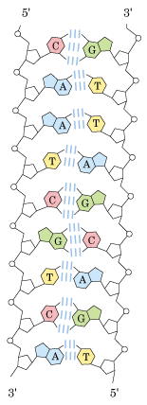

Slide 52
2.1.2 The characteristic bases can be regarded as side groups attaching to the backbone at regular intervals (similar to the R groups on a peptide chains).
2.1.3 Each DNA and RNA strands have a specific polarity with a distinct 5’ end (the end lacking a nucleotide at the 5’ position) and a 3’ end (the end lacking a nucleotide at the 3’ position). 5’-pCpGpT-3’-OH
2.1.4 The base sequence of a DNA or RNA molecule is always written with the 5’ end on the left and 3’ end on the right by convention.

Slide 53
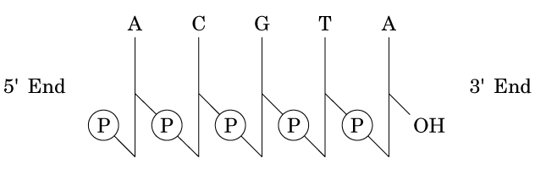
2.1.5 The nucleotide sequences of short segment of nucleic acids can be represented in different ways.
pA-C-G-T-A_{OH}
pApCpGpTpA
ACGTA

Slide 54
2.1.6 An oligonucleotide refers to nucleic acids shorter than about 50 nucleotides.
2.1.7 The backbones of both DNA and RNA are hydrophilic, having negative charges at physiological pH, that are generally neutralized by positively charged proteins, metal ions, and polyamines in cells.

Slide 56
3. DNA was found to be the molecule storing the genetic information.
The biochemical investigation of DNA began with Friedrich Miescher in 1868.
The first direct evidence that DNA is the bearer of genetic information came in 1944 through a discovery made by Oswald T. Avery et al.

Slide 57
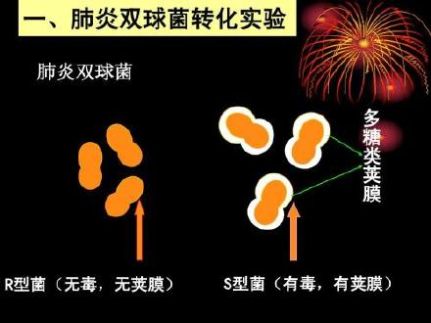

Slide 58
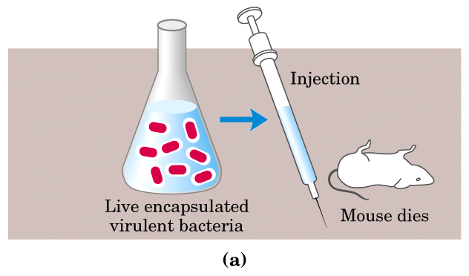

Slide 59
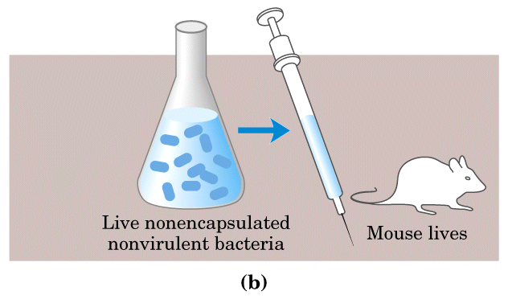

Slide 60
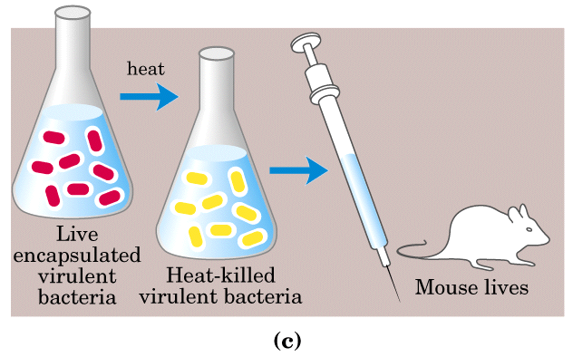

Slide 61
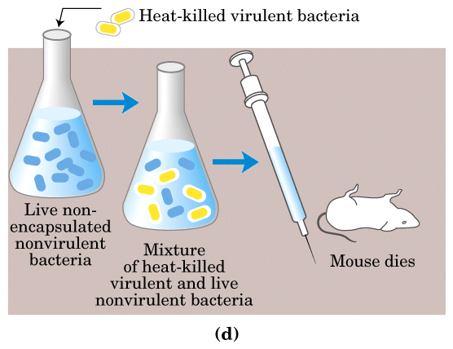

Slide 62
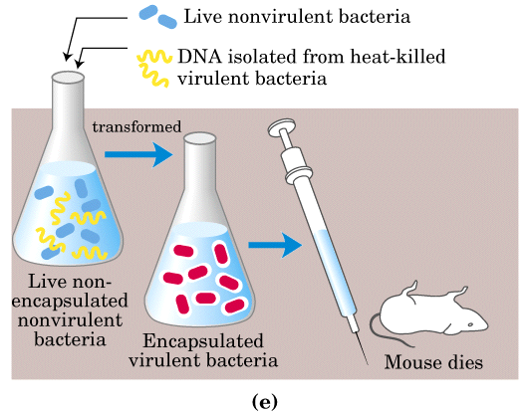

Slide 63
3.1 Avery and his colleagues discovered that a nonvirulent R form of pneumococcus bacterium (with rough colonies) can be transformed into the virulent S form (of smooth colonies).

Slide 64
3.2 DNA was found to carry the genetic information for virulence in the pneumococci transformation experiment.
3.2.1 Addition of DNA extracted from the heat-killed S form pneumococci (with protein removed as completely as possible) into live nonvirulent R form bacteria transformed the R form into a virulent S form permanently.
3.2.2 Treatment with proteolytic enzymes (trypsin, chymotrypsin) did not have any effect on the transformation activity.

Slide 65
3.2.3 Treatment with ribonuclease (known to digest RNA) had no effect on the transformation activity.
3.2.4 Treatment with deoxyribonuclease (known to digest DNA) destroyed the transformation activity.
3.2.5 Chromosomal proteins were assumed to carry the genetic information (with DNA playing a secondary role) until Avery, MacLeod, McCarty performed these experiments in 1944.

Slide 66
3.3 Further support for the genetic role of DNA came from the studies of T2 bacteriophage (a bacterial virus) that infects E.coli.
3.3.1 The T2 bacteriophage consists of a core of DNA surrounded by a protein coat.
3.3.2 Alfred Hershey and Martha Chase demonstrated that at infection only DNA (labeled with radioisotope ³²P) entered E.coli cells, proteins (labeled with ³⁵S) did not enter the host cells (1952).
3.3.3 DNA provided the genetic information for bacteriophage replication within the E.coli cells.

Slide 67
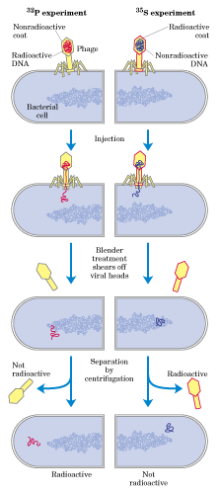

Slide 68
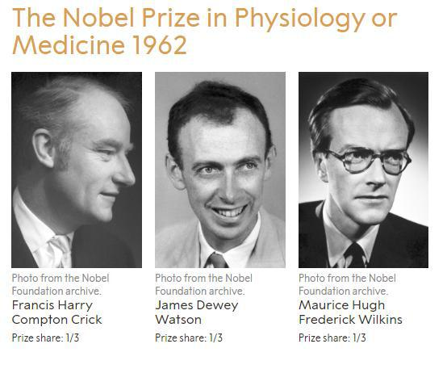
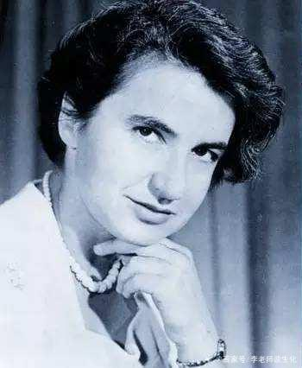
4. DNA molecules are double helices.
Rosalind Franklin

Slide 69
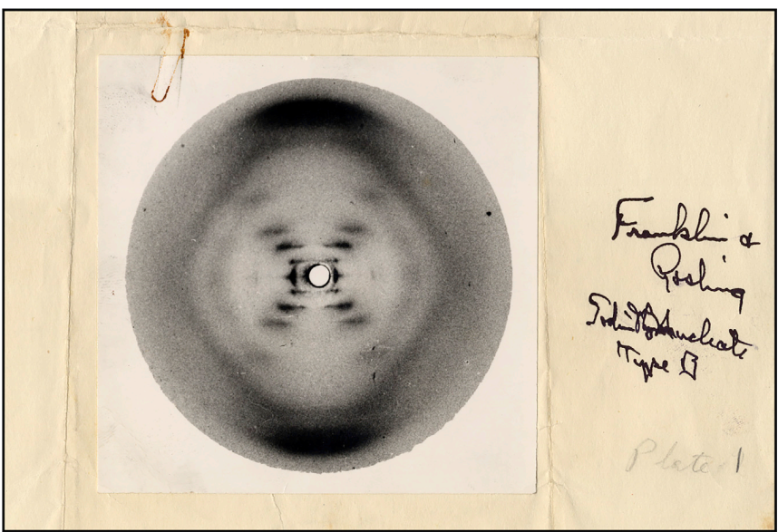

Slide 70
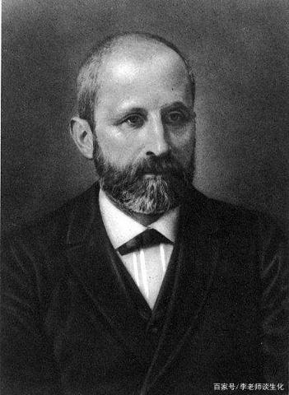
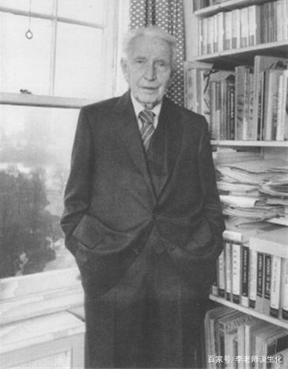
米歇尔
Erwin Chargaff

Slide 71
Watson and Crick proposed a double helix model based mainly on three main pieces of evidence.
A) the fact that the DNA molecule is composed of bases, deoxyriboses, and phosphate groups linked together as a polydeoxyribonucleotide.
B) X-ray diffraction pattern of DNA fibers, suggesting a helical structure with two distinctive regularities of 3.4 and 34 Angstroms along the axis of the molecule.
C) Chargaff’s discovery on the quantitative relationships between the bases (A=T, G=C).

Slide 72
DNA的碱基组成
Chargaff规则：
一种生物的所以体细胞的DNA碱基组成均相同
不同生物碱基组成差异大，可用不对称比率表示
（A＋T）/(G+C)
亲缘近的生物，其碱基组成相似
同一生物内，DNA分子组成 A=T G=C
同一生物的DNA分子 Pu=Py

Slide 73
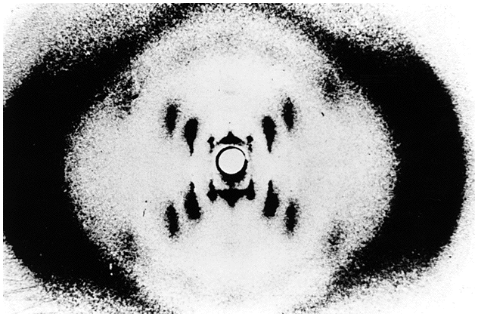

Slide 74
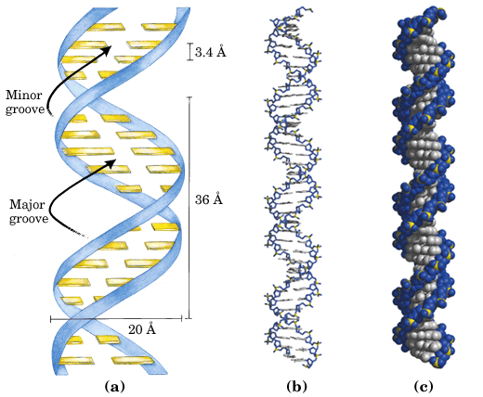
34

Slide 75
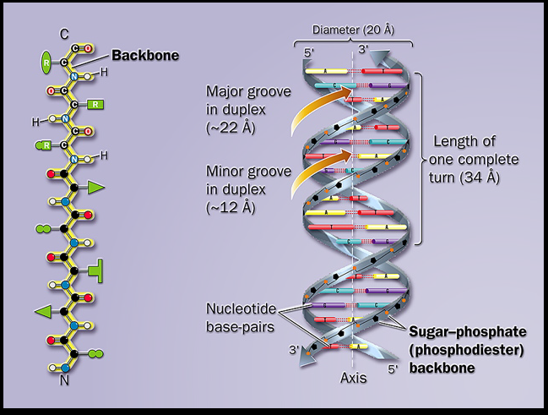

Slide 76
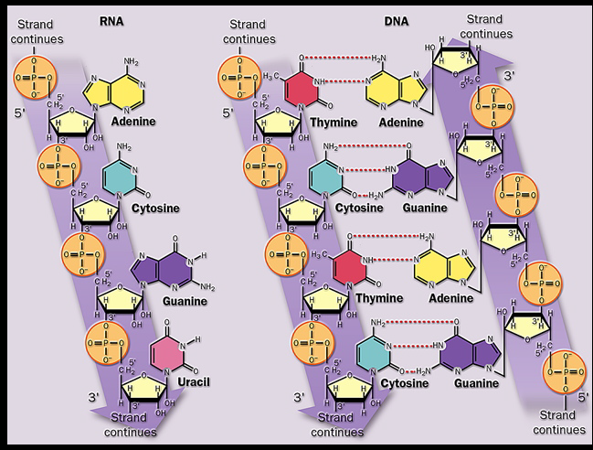

Slide 77
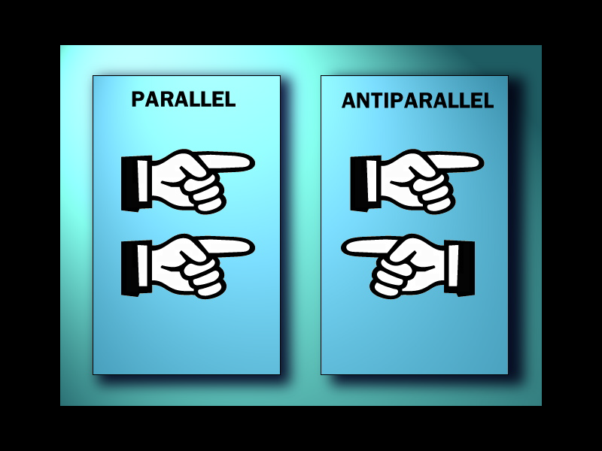

Slide 79
4.1 DNA double helix
4.1.1 The DNA molecule is a right-handed double helix containing two antiparallel strands.
4.1.2 The phosphate-deoxyribose backbones are on the outside of the helix, whereas the purine and pyrimidine bases are stacked inside.
4.1.3 The two antiparallel chains are complementary to each other through hydrogen bonds between pairs of bases（A=T, G=C）.
4.1.4 The base-stacking interactions make a major nonspecific contribution to the stability of the duplex.

Slide 80
Detailed information of DNA double helix
34

Slide 81
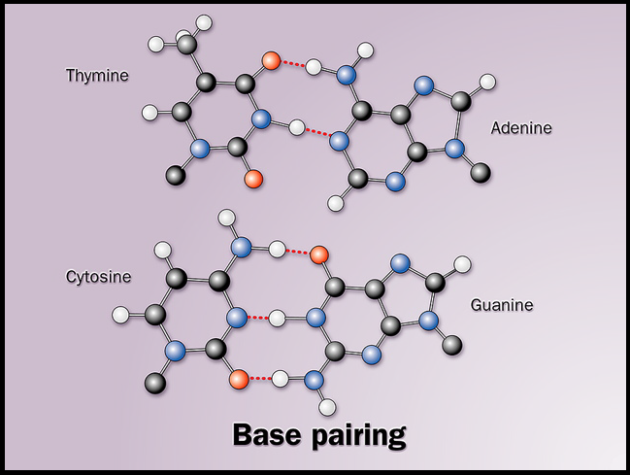

Slide 82
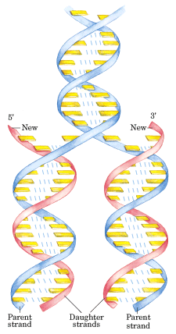
4.2 The double-helical model of DNA immediately suggested a mechanism for the replication of DNA.

Slide 83
4.3 DNA can occur in different structural forms.
4.3.1 DNA is remarkably flexible molecule with many rotatable bonds (thermal fluctuations producing bending, stretching, and unpairing).
4.3.2 The duplex structure proposed by Watson and Crick is referred as the B-form DNA, and is found to be the most stable structure for a random nucleotide sequence under physiological conditions. Thus it is the standard structure for DNA molecules.

Slide 84
4.3.3 At reduced humidity the DNA molecule will take the A-form: it is still a right-handed duplex made up of antiparallel strands held together by Watson-Crick base pairing.
4.3.4 The A-form helix is wider and shorter than the B-form helix. The plane of the base pairs in A-DNA is tilted about 20° with respect to the helix axis.

Slide 85
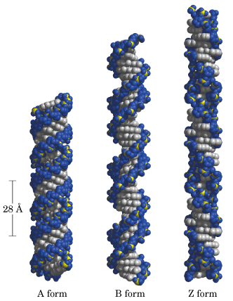

Slide 86
4.3.5 The Z-form DNA is a left-handed double helix in which backbone phosphates zigzag.
4.3.6 The biological roles of Z-DNA is uncertain (may play roles in gene expression and genetic recombination).

Slide 87
5. RNA molecules do not form simple, regular secondary structure but many form complex and unique three dimensional structures. (G1)
5.1 Single strand RNA tends to take right-handed helical conformation.
5. 2 Self-complementary sequences on a RNA molecule lead to specific structures.
5. 3 The standard base-pairing rules are followed (i.e., A with U, G with C).
5.4 Intrastrand base pairing makes structures including internal loops, and hairpins (helical).

Slide 88
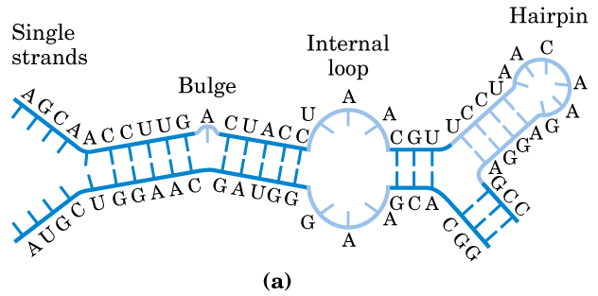

Slide 89
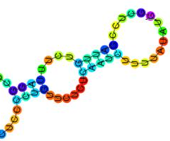
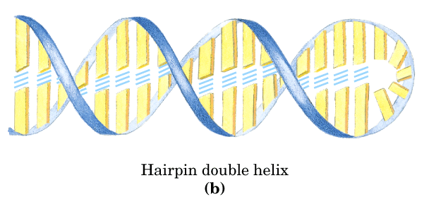

Slide 90
6. Duplex DNA and RNA molecules can be denatured and renatured.
6.1 Denaturation
6.1.1 Viscosity decreases sharply.
6.1.2 UV absorption at 260 nm increases significantly, an effect called hyperchromism or hyperchromic effect (增色效应).
DNA 复性——减色效应（hypochromic effect）

Slide 91
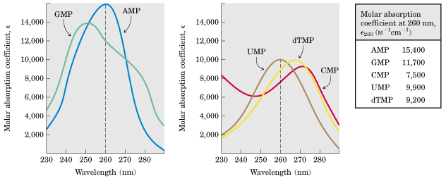
核酸、核苷酸的紫外吸收性质

Slide 92
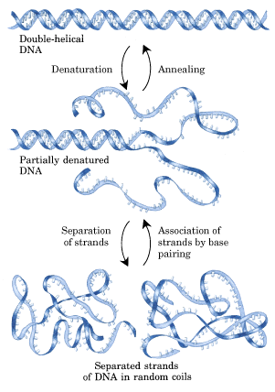
renaturation
melting

Slide 93
6.1.3 The unwinding (i.e., denaturation) of the double helix is called melting.
6.1.4 Each species of DNA has a characteristic melting temperature (Tm or tm) at which half of the duplex chain is separated. (The
midpoint of the temperature range over which denaturation occurs is called the melting temperature, or Tm. )
6.1.5 Tm has an approximate linear relationship with (G+C)%).
6.1.6 DNA segments rich in AT base pairs are melted first (at lower temperatures).

Slide 94


Slide 95


Slide 96


Slide 97


Slide 98
DNA的Tm值与下列因素有关
DNA的均一性
G-C含量
介质的离子强度

Slide 99
6.2 When the temperature or pH is returned to the biological range, the two separated complementary strands will spontaneously rewind (renature) to form a duplex structure.
6.2.1 This renaturation process is called annealing.
6.2.2 Annealing can occur between complementary DNA, RNA, or DNA-RNA hybrids.
6.2.3 This hybridization principle is widely used in detecting existence of specific DNA or RNA species in cells.

Slide 100

分子杂交

Slide 101


Slide 102


Slide 103
Southern blot
1. Digest DNA with restriction
enzymes
3a. Transfer separated DNA
onto membrane for further
analysis
2. Separate fragments
on agarose gel
3b. Synthesize labeled
cDNA probe
5. Wash the membrane
and expose with the film
4. Hybridize denatured
probe with the membrane
Denature
DNA
Add Klenow
DNA Polymerase,
random primers
and labeled
nucleotides
Klenow
Fragment
Klenow
Fragment

Slide 104
Northern blot
1. Collect cells or tissue
and extract RNA with
TRI Reagent (MRC)
3a. Transfer separated RNA
onto membrane
2. Separate RNA
on agarose gel
3b. Synthesize labeled
cDNA probe
5. Wash the membrane
and expose with the film
4. Hybridize denatured
probe with the membrane
Denature purified
DNA fragment
Add Klenow
DNA Polymerase,
random primers
and labeled
nucleotides
Klenow
Fragment
Klenow
Fragment

Slide 105
F2 DNA organization in chromosomes
Every cell of a multicellular organism generally contains the same genetic material.
DNA molecules are the largest macromolecules in the cell and are commonly packaged into structures called chromosomes.
Most bacteria and viruses have a single chromosome, whereas eukaryotic cells usually contain many.

Slide 106

DNA Molecules Are Much Longer than the Cellular or Viral Packages That Contain Them

Slide 107
1.Viral DNA molecules are relatively small
1.1 Viruses generally contain considerably less genetic information than cells.
An infectious virus particle often consists a single RNA or DNA molecule surrounded by a protein coat.

Slide 108


Slide 109




Slide 110



Slide 111


Slide 112


Slide 113

新型冠状病毒

Slide 114
2 Bacteria contain chromosomes and extrachromosomal DNA
2.1 Chromosomal DNA
The chromosome of an E. coli cell is a single double-stranded circular DNA molecule. Its 4,639,221 base pairs have a contour length of about 1.7 mm, some 850 times the length of the E. coli cell. Bacterial DNA must have an even more tightly compacted tertiary structure than the viral DNA.

Slide 115

The length of the E. coli chromosome (1.7 mm) is depicted in linear form relative to the length of a typical E. coli cell (2 μm)

Slide 116

蛋白质骨架
The DNA is negatively supercoiled, complexed to several histone-like proteins and organize into about 50 domains bound to a protein scaffold.

Slide 117


Slide 118



Slide 119


Slide 120


Slide 121


Slide 122


Slide 123


Slide 124
DNA超螺旋结构的拓扑学性质
DNA不同的空间分子构象又称为拓扑异构体(topoisomer)，其拓扑学特性可以用3个参数来描述。
连环数（L, linking number）、
盘绕数（T , twsting number）、
超螺旋周数（W , writhing number）
L = T + W

Slide 125
2.2 Extrachromosomal DNA
In addition to the very large, circular DNA chromosome in the nucleoid, many bacteria contain one or more small, circular DNA molecules that are free in the cytosol. These extrachromosomal elements are called plasmids.

Slide 126
plasmid
DNA from a lysed E. coli cell

Slide 127
3. Eukaryotic cells contain more DNA than prokaryotes
Human cells and many other mammalian cells have about 600 times as much DNA as E. coli. The plants contain an even greater amount.
The total contour length of all the DNA in a single human cell is about 2 m.

Slide 128


A single human chromosomes.
Complete set of chromosomes from a leukocyte. There are 46 chromosomes in each normal human somatic cell.

Slide 129
The eukaryotic cell cycle produces remarkable changes in the structure of chromosomes (Fig. 24-22). In nondividing eukaryotic cells (in the G0 phase) and those in interphase (G1, S, and G2), the chromosomal material, chromatin, is amorphous. In the S phase of interphase, the DNA in this amorphous state replicates, each chromosome producing two sister chromosomes (called sister chromatids) that remain associated with each other after replication is complete. The chromosomes become much more condensed during prophase of mitosis, taking the form of a species-specific number of well-defined pairs of sister chromatids

Slide 130
In the eukaryotic cell cycle, interphase chromosomes
appear, at first viewing, to be dispersed and amorphous. Nevertheless, several forms of chromatin can be found along these chromosomes. About 10% of the chromatin in a typical eukaryotic cell is in a
more condensed form than the rest of the chromatin. This form, heterochromatin, is transcriptionally inactive. Heterochromatin is generally associated with particular chromosome structures — the centromeres, for example. The remaining, less condensed chromatin is called euchromatin.

Slide 131

chromosome
chromatin
Changes in chromosome structure during the eukaryotic cell cycle.

Slide 132


Chromatin fiber
(30 nm in diameter)
Nucleosomes
(10 nm in diameter)
Histones
DNA

Slide 134
Chromosomes contain both DNA and protein. Most of the protein are histones, but there are also nonhistone proteins.
In the nucleus, each chromosome contains a single linear double-stranded DNA molecule.

Slide 135
4. Nucleosomes
When chromosomes are gently “condensed”, they have the appearance under the electron microscope of “beads on a string”. The “beads” are called nucleosomes and consist of DNA complexed with histones.

Slide 136



Slide 137


Slide 138


Slide 139



H3 methylation
H3K4, H3K27
H3K9, H3K36

Slide 140


Slide 141


Slide 142


Slide 143

30nm chromatin fiber
每圈6核小体

Slide 144


Slide 145

Two chromatids (10 coils each)
One coil (30 rosettes)
One rosette
Nuclear scaffold
One loop (-75,000 bp)
30 nm Fiber
“Beads –on-a-string” form of chromatin
DNA

Slide 146


Slide 147


Slide 148
DNA Replication (F3F4)
How does a DNA molecule replicate with high fidelity?

Slide 149
1. The deduced double helix structure of DNA revealed the possible ways for its replication (1953)
The hypothesis of
semiconservative
replication proposed
by Watson and Crick
in 1953.

Slide 150
2. DNA replication was proved to be semiconservative by the Meselson-Stahl experiment using E. coli cells (1957)
¹⁵N (the Heavy isotope) and ¹⁴N (the Light isotope) was used (as NH₄Cl) to label the DNA to distinguish the old and newly synthesized DNA molecules in cells;
Three types of DNA molecules containing various proportions of ¹⁵N and ¹⁴N (H-H, H-L, L-L) were separated by centrifugation to equilibrium in a cesium chloride (CsCl) density gradient.

Slide 151

Radioisotope labeling
and density gradient
centrifugation clearly
distinguishes
replications of
semiconservative
from conservative.

Slide 152

¹⁵N-¹⁵N
Top
Bottom
The Meselson-
Stahl experiment:
DNA molecules
duplicate
semiconservatively
in E. coli cells.
0 generation
1 generation
2 generations
3 generations
4 generations
0 and 2 mixed
0 and 4 mixed
¹⁴N-¹⁴N
¹⁵N-¹⁴N
¹⁵N-¹⁵N

Slide 153
3. A variety of simple questions were asked about DNA replication
Are the two parental strands completely unwound before replication begins?
Does replication begin at random sites or at unique sites?
Does DNA replication proceed in one direction or both directions?
The overall chain growth occurs in 5` 3`, 3` 5`, or both directions?
What enzymes take part in DNA synthesis?

Slide 154


4. Autoradiography studies: daughter strands are synthesized immediately after parental strands separate

Slide 155
A electron micrograph of the replication
intermediate of a plasmid DNA: θ-shaped
structures were observed; no single stranded
DNA is visible.
No complete unwinding of the two parental strands occurred before the daughter strands are synthesized

Slide 156


Slide 157

Bidirectional replication of a circular bacterial replicon
Origin
Terminus

Slide 158
5. DNA replication was found to begin at specific sites and proceed bidirectionally
1. Replication always began at a specific internal site (not from the ends, not random);
2. The replication proceeds in both directions (determined by measuring the distance between the replication fork and the ends)

Slide 159
6. The chemistry of DNA polymerization was revealed by in vitro studies using a DNA polymerase purified from E. coli
DNA polymerase I was found to catalyze DNA polymerization in vitro in the presence of a single-stranded DNA template, a preexisting primer with a free 3`-OH group and the dNTPs.

Slide 160

pyrophosphate

Slide 161


Slide 162
7. DNA polymerase I has 3` 5`, as well as 5` 3` exonuclease activities
The 3` 5` exonuclease activity was also found to be able to remove mismatched base pairs, thus to proofread the newly incorporated nucleotides.
The 5` 3` exonuclease activity of DNA polymerase I enable it to catalyze the nick translation process: an RNA or DNA strand paired to a DNA template is simultaneously degraded and replaced; an activity used for the removal of RNA primers in DNA replication.

Slide 163
7. DNA polymerase I has 3` 5`, as well as 5` 3` exonuclease activities
The 3` 5` exonuclease activity was also found to be able to remove mismatched base pairs, thus to proofread the newly incorporated nucleotides.
The 5` 3` exonuclease activity of DNA polymerase I enable it to catalyze the nick translation process: an RNA or DNA strand paired to a DNA template is simultaneously degraded and replaced; an activity used for the removal of RNA primers in DNA replication.

Slide 164

Protease cleavage
DNA polymerase I has three enzymatic
activities in a single polypeptide chain,
which can be cleaved into two functional
parts by mild protease treatment.

Slide 165

Arthur Kornberg won
the 1959 Nobel Prize
in Medicine for his
discovery of the
mechanism in the
biological synthesis of
deoxyribonucleic acid
(before Watson and
Crick won theirs!)

Slide 166
8. DNA polymerase I was found to be not responsible for DNA replication in E. coli cells
The reaction velocity of this enzyme is too low to account for the observed rates of fork movement.
E.coli cells having a defective DNA polymerase I were found to be still viable, although sensitive to UV light (1969).
Two more DNA polymerases (II and III) were revealed in E.coli cells in the early 1970s and two more in 1999.

Slide 167

9. The synthesis of the two daughter DNA strands was found to be semidiscontinuous
Overall direction of progeny chain growth
at a replicating fork: one in 5’ 3’ and the
other in 3’ 5’ direction.

Slide 168
9. The synthesis of the two daughter DNA strands was found to be semidiscontinuous
At a replication fork, the overall elongation direction for one daughter strand is 5` to 3` and 3` to 5` for the other due to the antiparallel features of DNA duplexes.
Reiji Okazaki discovered ( in the 1960s) that a significant proportion of newly synthesized DNA exists as small fragments!

Slide 169
These so-called Okazaki fragments were found to join together by DNA ligases to form one of the daughter strands;
Thus both daughter strands are synthesized in 5` to 3` direction.
One daughter strand at the replication fork is synthesized continuously and the other discontinuously, called the leading and lagging strands respectively.

Slide 170

The leading strand
The lagging strand
Both daughter strands at the replication fork are synthesized in
5’ 3’ direction, but one (the leading strand) is synthesized
continuously and the other (the lagging strand) discontinuously
(synthesized initially as Okazaki fragments).

Slide 171

10. DNA polymerase III is responsible for DNA replication in E.coli cells
◆ DNA polymerase III is the principle replication enzyme in E.coli.

Slide 172

Sliding clamp
subunits
Clamp
loader
Proposed
architecture of DNA
polymerase III
holoenzyme:
an asymmetric
dimer
Catalytic
subunit
Catalytic
subunit
3’ 5’ exonuclease
subunits
No 5` to 3` exonuclease
activity

Slide 173


Slide 174
11. DNA polymerase III and many other proteins are part of the replisome for DNA replication in E.coli cells
In vitro studies revealed about 20 proteins are involved in DNA replication in E.coli cells.
Accessory proteins include:
  the helicase (解螺旋酶）for moving along the DNA and separating the two DNA strands using energy from ATP;
  the single stranded DNA-binding (SSB) protein for binding and stabilizing the single stranded DNA generated;
①
②

Slide 175
  the topoisomerases （拓扑异构酶）for relieving topological (torsional) strains in the helical structure (positive supercoils) generated during strand separation;
  the primase for generating a short RNA primer;
  the DNA polymerase III for polymerizing and proofreading the nucleotides according to the templates;
  the DNA polymerase I for removing the RNA primers and replacing by a DNA sequence;
  the DNA ligase for sealing nicks between the Okazaki fragments.
③
④
⑤
⑥
⑦

Slide 176

RNA primers are
repeatedly formed
by the primase on
the lagging strand.

Slide 177

DNA polymerase I replaces the RNA primers by
DNA sequences and DNA ligase seals the nicks

Slide 178


DNA ligase first transfers
an AMP moiety to the 5`
phosphate group (from
NAD⁺ or ATP) before
making a phosphodiester
bond.

Slide 179
12. DNA replication in eukaryotic cells use essentially the same principles but more complex in the details (F4)
The rate of DNA synthesis in eukaryotic cells is about one tenth of that of the E.coli cells.
Replication in the eukaryotic genomes begin at many replication origins.

Slide 180

12.1 Cell cycle
In eukaryotes, the cell cycle consists of G₁, S, G₂ and M phases. Quiescent cells are said to be in G₀ phase.
G (gap); S (synthesis); M (mitosis)

Slide 181


Slide 182


Slide 183


Slide 184


Slide 185

Mitosis and cell division occur in the M phase which lasts for only about 1 h.

Slide 186

12.2 DNA replication occurs only in the S phase.
many chromosomal origins (multiple replicons);
bi-directional; semi-conservative
Replication bubble

Slide 187
12.3 Eukaryotic cells contain five different DNA polymerases
DNA polymerases α and δ replicate chromosomal DNA
DNA polymerases β and ε repair DNA
DNA polymerase γ replicates mitochondral DNA.

Slide 188
12.4 Telomere replication (端粒复制）
Different with the circular DNA in bacteria, eukaryotic DNA is a linear molecule. According to the mechanism of replication, the 3’ end of lagging chain is not replicated. This creates a gap at the end of the chromosome and therefore a shortening of the double-stranded replicated portion. In many organisms the solution is to use an enzyme called telomerase (端粒酶）to replicate the chromosome ends (telomeres).

Slide 190

Telomerase, a DNA polymerase that contains an integral RNA that acts as its own primer, is used to replicate DNA at the ends of chromosomes (telomeres).

Slide 192
12.5 Nucleosomes do not dissociate from the DNA during DNA replication.
When a chromosome is replicated, the histones stay in place but somehow must allow the replication machinery to pass through and make new DNA. One suggestion is that the nucleosome histone octamer transiently unfolds into two half-nucleosomes to allow the replication machinery access to the DNA. The new DNA must also be packaged into nucleosomes and so histones are also synthesized during the S phase of the cell cycle.

Slide 193

逆转录病毒

Slide 194
END
Thank you

Slide 195
Date：2018/10/18
Name： Student number： Class：
Q: How does a DNA molecule replicate with high fidelity in E. coli ?
A：

